Slide 1
Operations Research and Systems Analysis
Linear Programming
Notes:
Meadows – show slinky

Slide 2
Linear programming
Seeks to maximize or minimize a linear objective function
Subject to a set of linear constraints.
Linear programming model consists of:
A set of decision variables.
An objective function.
A set of constraints.

Slide 3
Linear optimization model
min z = c₁x₁ + c₂x₂ + … + c_{n}x_{n}
Subject to
a₁₁x₁ + a₁₂x₂ + … + a_{1n}x_{n} ≥ b₁
a₂₁x₁ + a₂₂x₂ + … + a_{2n}x_{n} = b₂
:
a_{m1}x₁ + a_{m2}x₂ + … + a_{mn}x_{n} ≤ b_{m},
x^{T}=(x₁, x₂, ..., x_{n})^{T} ≥ 0 ∈ R^{n}

Slide 4
Linear optimization model

Slide 5
Simplex Method
Simplex method
Starts with a feasible solution
Tests whether or not it is optimum.
If not, the method proceeds a better solution
It is based on Jordanian elimination procedure.
It deals with equations and not with inequations

Slide 6
Simplex Method
Converting LP into equations
Add slack variables
Reserve:
Surplus:

Slide 7
Simplex method
Converting LP into a canonical form
Add artificial variables
High unit costs: M
Where o^{T} = (0;0;0…..0) and m^{T} = (M;M;M…..M)
M could be stated as 100*bigger number than other prices, negative for maximization, positive for minimisation.

Slide 8
Simplex table
Basis | C_{j} | Names of variables | b_{i} | Ω
 |  | Objective function coefficients
Names of basic variables | Basic variables objective function coefficients | Left sides of constraints | RHS | Test for feasibility
Z_{j} – c_{j} |  | Test for optimality, shadow prices | Actual value of objective function

Slide 9
Sensitivity analysis (I)
Initial non-basic variables
Initial basic variables
Initial simplex table in canonical form
B | N | I | = | b
c^{B} | c^{N} | 0 |  | 0
Basis matrix
β = B⁻¹b
Final basic variables
Final non-basic variables
Final simplex table in canonical form
I | N‘ | B⁻¹ | = | β
0 | c^{N‘} | c^{B-1} |  | Z_{opt}
Basis matrix inverse / Transformation matrix
Sensitivity of objective function coefficients
Sensitivity of RHS

Slide 10
Sensitivity analysis (II)
Sensitivity of objective function coefficients
Basic variables
Non-basic variables
Sensitivity of RHS
β = B⁻¹b ≥ 0
Intervals of stability

Slide 11
Sensitivity analysis (III)
λ_{k} is change of b_{k}
b_{kλ} = b_{k} + λ_{k}
α_{ik} are elements of B⁻¹
For α_{ik} > 0
For α_{ik} < 0

Slide 12
Example (I)
You are manager of automobile company. Now you must plan the capacity of new factory for finalization of new cars.
The factory could produce 4 types of cars:
Sport utility vehicles SUV,
Multi-purpose vehicle MPV,
Small town car,
Van.

Slide 13
Example (II)
The production depends on marketing requirements (demanded mix of cars), production capacity (max 1000 of car equivalent units (CEU)). The company maximises its profit.
 | SUV | MPV | Small | Van
Marketing requirements (cars/day) | 50 | 30 | 200 | 30
CEU | 3 | 2 | 1 | 2
Profit (thousands CZK) | 300 | 220 | 120 | 200

Slide 14
Example (III)
Create the linear optimization model.
Use simplex method to find optimal solution of the example.
Use SW Linea to find optimal solution of example.
Use SW Linkosa to find optimal solution of the example.
Use Solver to find optimal solution of the example.
Interpret/explain the solution.

Slide 15
Solve the example by hand
Simplex method
Sensitivity analysis
Notes:
Slack variables
Artificial variables

Slide 16
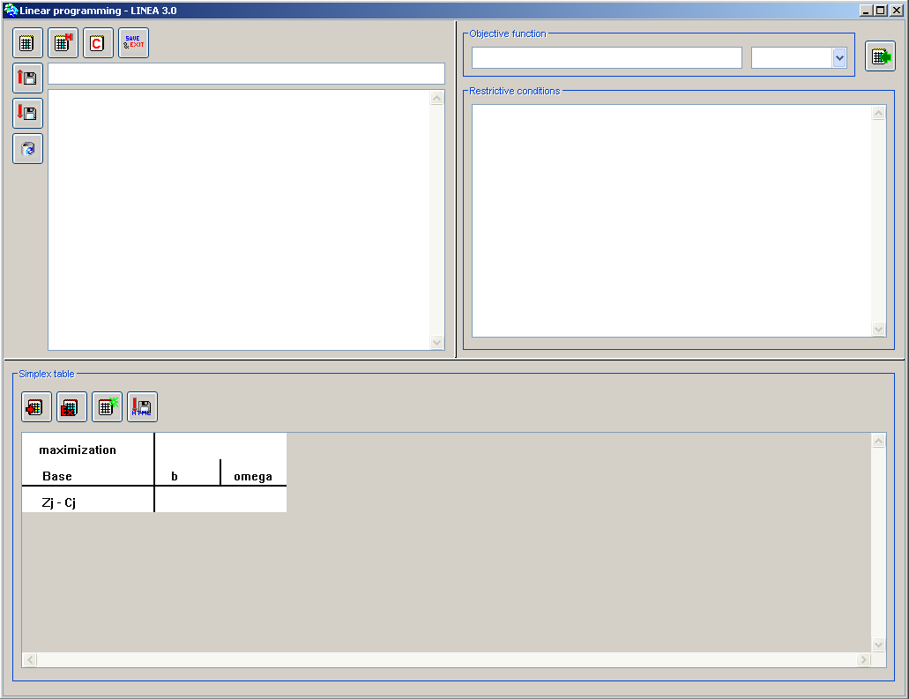
Use SW Linea to find optimal solution of the example

Slide 17
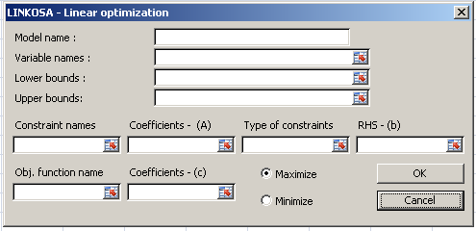
Use SW Linkosa to find optimal solution of the example
MS Excel add in
Notes:
Zkusit měnit pravé strany a ceny

Slide 18
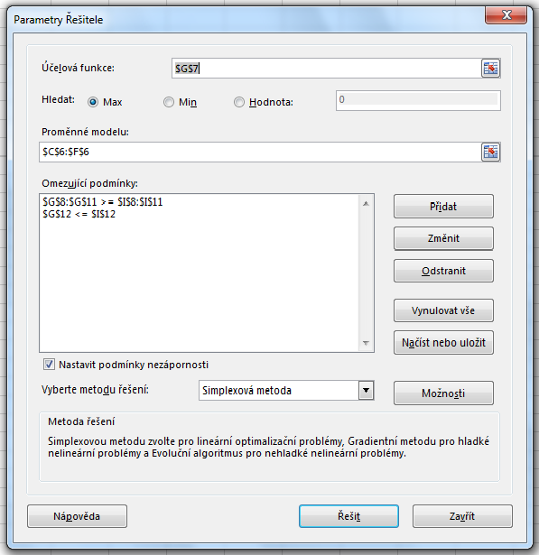
Use Solver to find optimal solution of the example
MS Excel: Data → Solver

Slide 19
Thank you for your attention.

